Slide 1

Unit-V
Adaptive resonance Theory(ART)
Course In-Charges:
Dr.A.Mary Posonia
Dr.B.Ankayarkanni
SIT1305 Machine Learning

Slide 2
ART – Adaptive Resonance Theory
Adaptive resonance theory is a type of neural network technique developed by Stephen Grossberg and Gail Carpenter.
The basic ART uses unsupervised learning technique in 1987
Adaptive: open to new learning
Resonance : Without discarding the previous or the old information
The ART networks are known to solve the stability-plasticity dilemma i
SIT1305 Machine Learning

Slide 3
ART
ART networks implement a clustering algorithm
Input is presented to the network
Algorithm checks whether it fits into one of the already stored clusters
If it fits then the input is added to the cluster
Otherwise new cluster is formed.
SIT1305 Machine Learning

Slide 4
Types of Adaptive Resonance Theory(ART)
ART1 – It is the simplest and the basic ART architecture. It is capable of clustering binary input values.
ART2 – It is extension of ART1 that is capable of clustering continuous-valued input data.
Fuzzy ART – It is the augmentation of fuzzy logic and ART.
ARTMAP – It is a supervised form of ART learning where one ART learns based on the previous ART module. It is also known as predictive ART.
FARTMAP – This is a supervised ART architecture with Fuzzy logic included.
SIT1305 Machine Learning

Slide 5
Adaptive Resonance Theory (ART) Architecture
Unsupervised ones(ART1, ART2, ART3, etc)
Supervised ones(ARTMAP)
Basic ART model is unsupervised in nature
F1 layer or the comparison field(where the inputs are processed)
F2 layer or the recognition field (which consists of the clustering units)
The Reset Module (that acts as a control mechanism)
SIT1305 Machine Learning

Slide 6
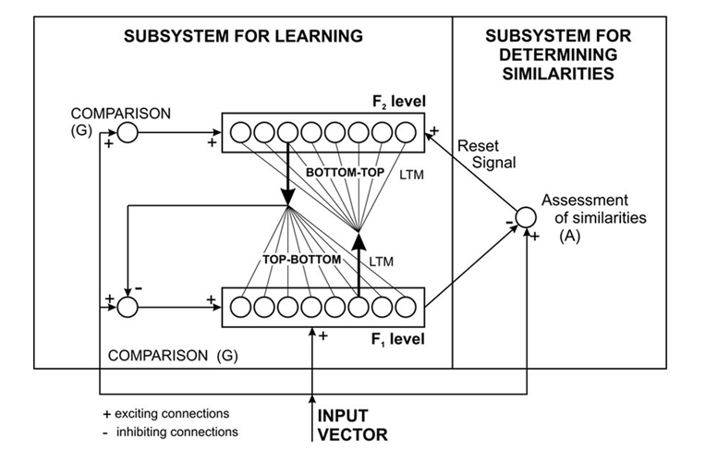
Adaptive Resonance Theory (ART) Architecture
SIT1305 Machine Learning

Slide 7
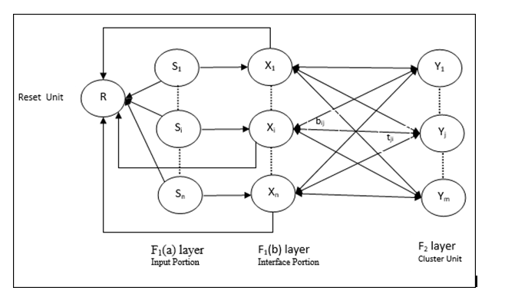
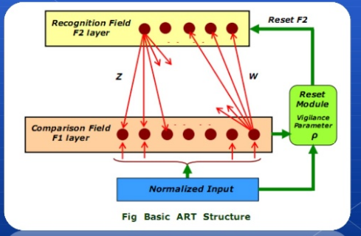
Adaptive Resonance Theory (ART) Architecture
SIT1305 Machine Learning

Slide 8
Adaptive Resonance Theory (ART) Process
The F1 layer accepts the inputs and performs some processing and transfers it to the F2
There exist two sets of weighted interconnection for controlling the degree of similarity between the units in the F1 and the F2 layer.
The F2 layer is a competitive layer.The cluster unit with the large net input becomes the candidate to learn the input pattern first and the rest F2 units are ignored.
The reset unit makes the decision whether or not the cluster unit is allowed to learn called vigilance test
vigilance parameter helps to incorporate new memories or new information.
SIT1305 Machine Learning

Slide 9
ART: Algorithm
Incoming pattern are matched with stored cluster template
If closed enough to cluster template joins best matching cluster, weights updated
If not new cluster is initialized with pattern as template
SIT1305 Machine Learning

Slide 10
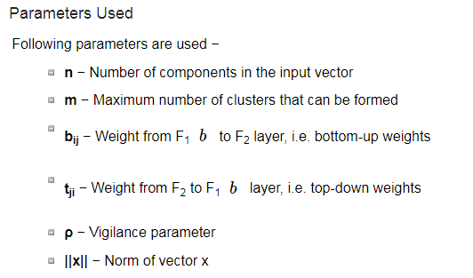
ART: Algorithm
SIT1305 Machine Learning

Slide 11
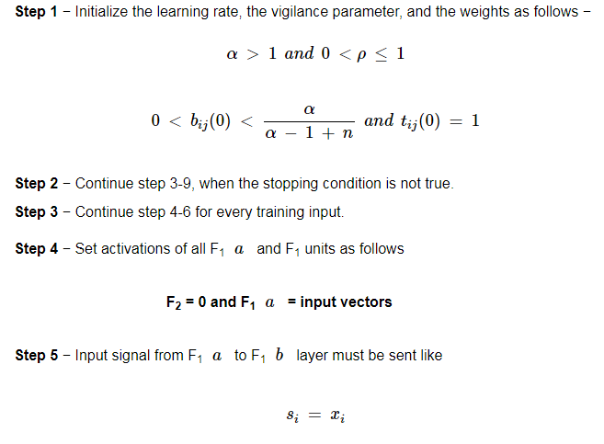
ART: Algorithm
SIT1305 Machine Learning

Slide 12
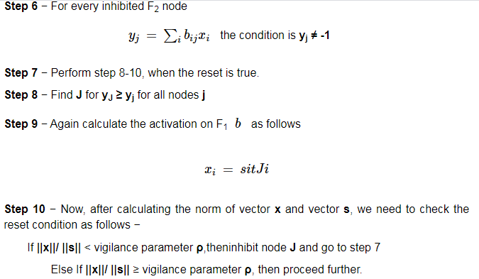
ART: Algorithm
SIT1305 Machine Learning

Slide 13
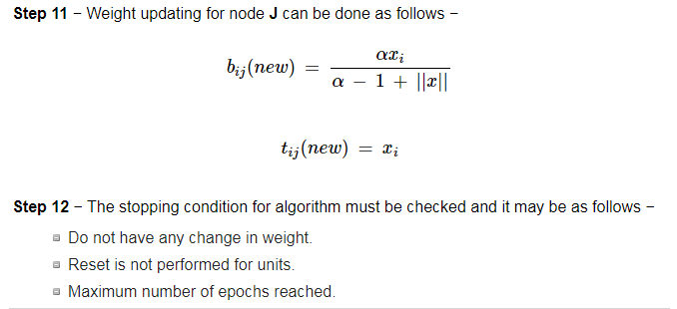
ART: Algorithm
SIT1305 Machine Learning

Slide 14
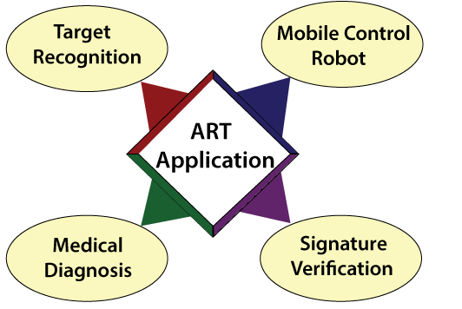
ART- Application
SIT1305 Machine Learning

Slide 15
Reinforcement learning
Reinforcement learning is an area of Machine Learning. It is about taking suitable action to maximize reward in a particular situation.
Software and machines to find the best possible behavior or path it should take in a specific situation.
supervised learning in a way that in supervised learning the training data has the answer key with it so the model is trained with the correct answer
whereas in reinforcement learning, there is no answer but the reinforcement agent decides what to do to perform the given task.
In the absence of a training dataset, it is bound to learn from its experience.
SIT1305 Machine Learning

Slide 16
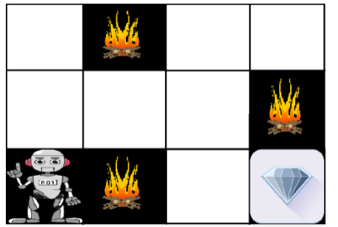
Example: Reinforcement learning
We have an agent and a reward, with many hurdles in between. The agent is supposed to find the best possible path to reach the reward.
The above image shows the robot, diamond, and fire.
The goal of the robot is to get the reward that is the diamond and avoid the hurdles that are fire.
he robot learns by trying all the possible paths and then choosing the path which gives him the reward with the least hurdles.
Each right step will give the robot a reward and each wrong step will subtract the reward of the robot.
The total reward will be calculated when it reaches the final reward that is the diamond.
SIT1305 Machine Learning

Slide 17
Reinforcement learning: Algorithm
Input: The input should be an initial state from which the model will start
Output: There are many possible output as there are variety of solution to a particular problem
Training: The training is based upon the input, The model will return a state and the user will decide to reward or punish the model based on its output.
The model keeps continues to learn.
The best solution is decided based on the maximum reward.
SIT1305 Machine Learning

Slide 18
Applications of Reinforcement Learning
RL can be used in robotics for industrial automation.
RL can be used in machine learning and data processing
RL can be used to create training systems that provide custom instruction and materials according to the requirement of students.
SIT1305 Machine Learning

